Slide 1
How to create and use an integration profile of type API Restrictions for Acquisitions
Yoel Kortick
Senior Librarian
October 2024

Slide 2
Agenda
Introduction
Creating the integration profile of type "API Restrictions“
Attributing the restriction profile to an API key
Testing the restriction profile – Creating a POL
Testing the restriction profile – Retrieving a POL
Testing the restriction profile – Retrieving vendors
Testing the restriction profile – Viewing funds
2

Slide 3
Introduction

Slide 4
Introduction
See also: Working with API Restriction Profiles
Each API key is restricted to the institution which created the API Key.
For example, if institution A created a read/write API key for area "Acquisitions" and gave it to third-party X then third-party X can use that API key to do the following in institution A:
  Create and retrieve POLs for any vendor
  Retrieve all vendors
  Retrieve all funds with the balance
By using an integration profile of type API Restrictions for Acquisitions the institution can restrict the above activities
  To be done only for a certain vendor.
  To not be able to see the fund balance

Slide 5
Introduction
By using an integration profile of type “API Restrictions” both the vendor and fund can be limited for a specific API key for GET and POST.
The integration profile of type “API Restrictions” is created and then associated with the API key.
This is currently relevant for acquisitions APIs for the following areas:
  Creating orders for vendors not associated with the restriction profile
  Retrieving orders with vendors not associated with the restriction profile
  Retrieving vendors not associated with the restriction profile
  Seeing the balance of all funds

Slide 6
Creating the integration profile of type "API Restrictions"

Slide 7
Creating the integration profile of type "API Restrictions"
We will create an integration profile of type "API Restrictions" at "Configuration > General > External Systems > Integration Profiles".
We will make the restriction be for vendor code ZER name "E Zafrani Physical and Electronic Resources Ltd.".
We click "Add Integration Profile" and in the field "Integration Type" we choose "API Restrictions"
In the Acquisitions section of the profile, we choose vendor code ZER name "E Zafrani Physical and Electronic Resources Ltd.".

Slide 8
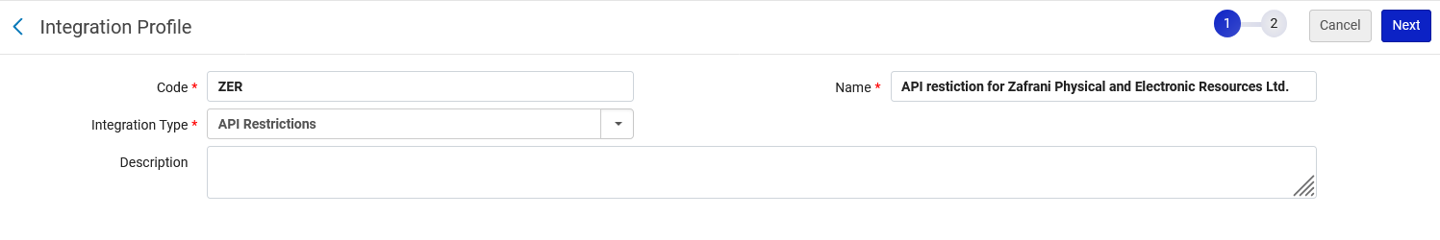
Creating the integration profile of type "API Restrictions"
Note that we gave the integration profile code ZER

Slide 9
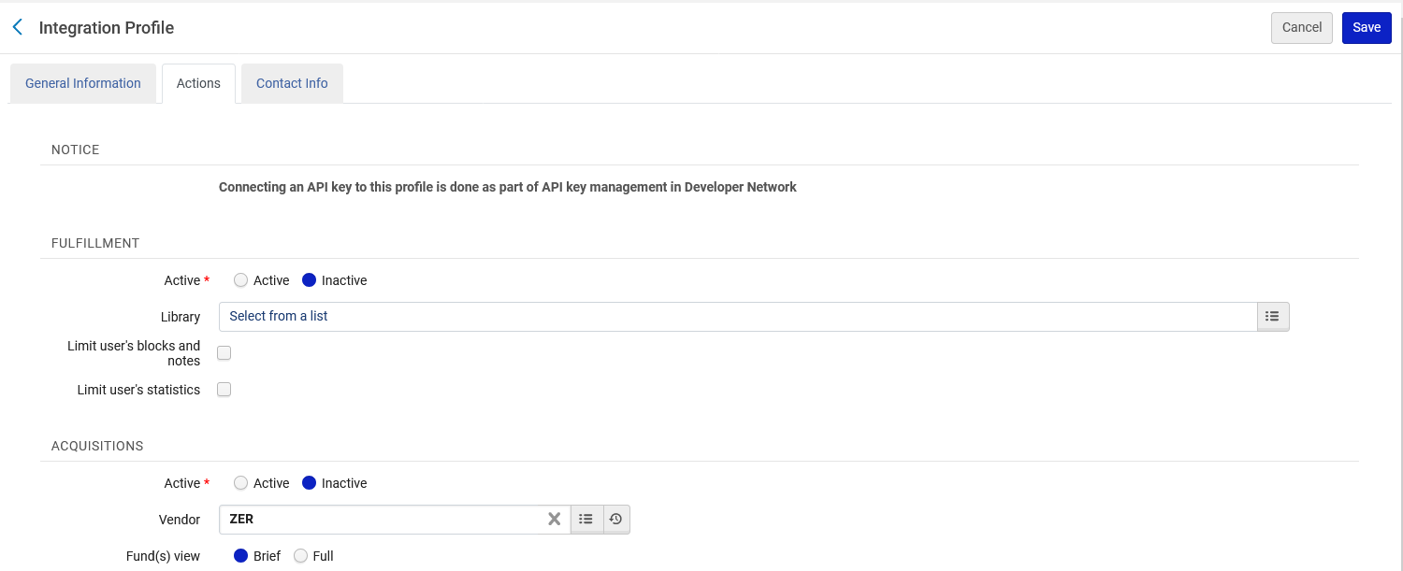
Creating the integration profile of type "API Restrictions"

Slide 10
Creating the integration profile of type "API Restrictions"
Regarding the vendor:
  This is used when submitting APIs.
  The specific vendor code used here must be the vendor code used for the API.
  In our example we used vendor code ZER name "E Zafrani Physical and Electronic Resources Ltd.".
  This means that only PO lines with vendor code ZER in the payload will be created. If a different vendor code is in the payload, then the PO line will not be created.
Regarding the fund(s) view:
  This determines whether the GET funds API should return the fund balance.
  If “Brief” is used, then balance will not be returned.
  In our example we used Brief

Slide 11
Attributing the restriction profile to an API key

Slide 12
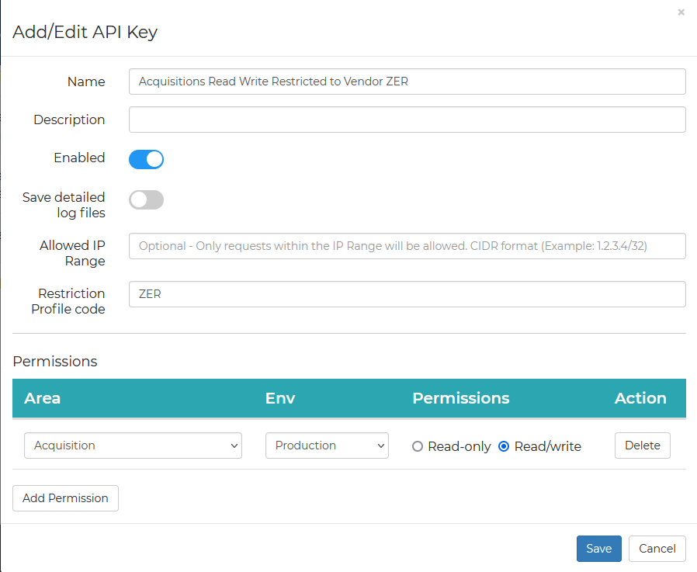
Attributing the restriction profile to an API key
When adding the API key for acquisitions we can add the API restriction profile code to the API.
This is the name of the API Key which uses the API Restrictions integration profile code ZER
In the API key definition, we have added the API Restrictions integration profile code ZER

Slide 13
Attributing the restriction profile to an API key
Now when we use this API key we should
  Be able to create and retrieve POLs for vendor code ZER (Zafrani Physical and Electronic Resources Ltd.).
  Not be able to create and retrieve POLs if the vendor is not ZER (Zafrani Physical and Electronic Resources Ltd.)
  Only be able to retrieve vendor which has code ZER
This is because restriction profile ZER uses vendor ZER (Zafrani Physical and Electronic Resources Ltd.).
Not be able to see fund balance
  This is because restriction profile ZER has “Fund(s) view” as “Brief”

Slide 14
Testing the restriction profile – Creating a POL

Slide 15
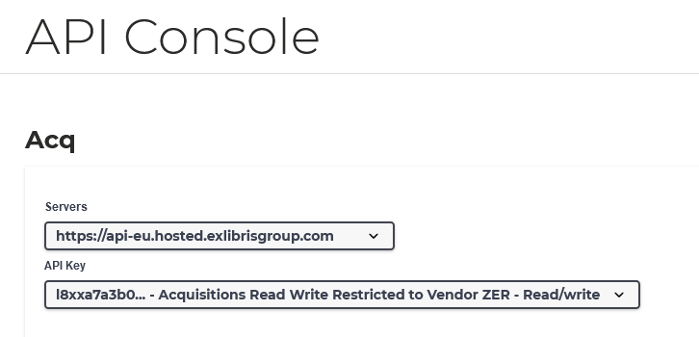
Testing the restriction profile – Creating a POL
We will use the API key with restriction profile ZER to create (POST) a POL

Slide 16
Testing the restriction profile – Creating a POL
In this example we will see that when using an API connected to the restriction profile which has vendor ZER
  We can create a POL if the vendor of the POL is ZER
  We cannot create a POL if the vendor of the POL is not ZER.
Thus, we are restricted to use a specific vendor for POL creation.

Slide 17
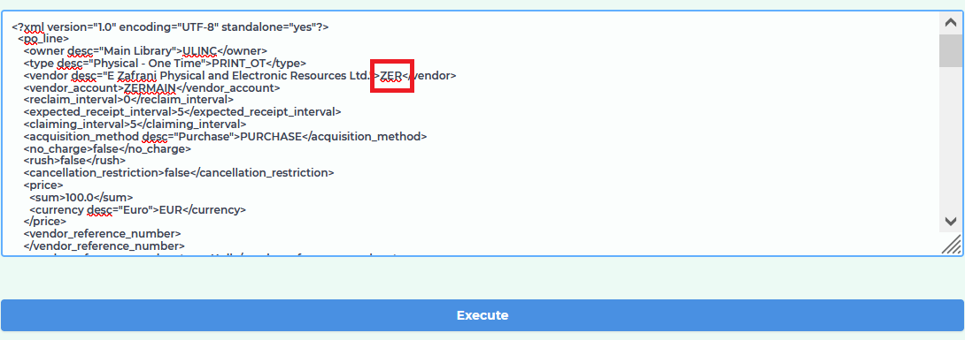
Testing the restriction profile – Creating a POL
The Payload when creating the POL has vendor code ZER

Slide 18
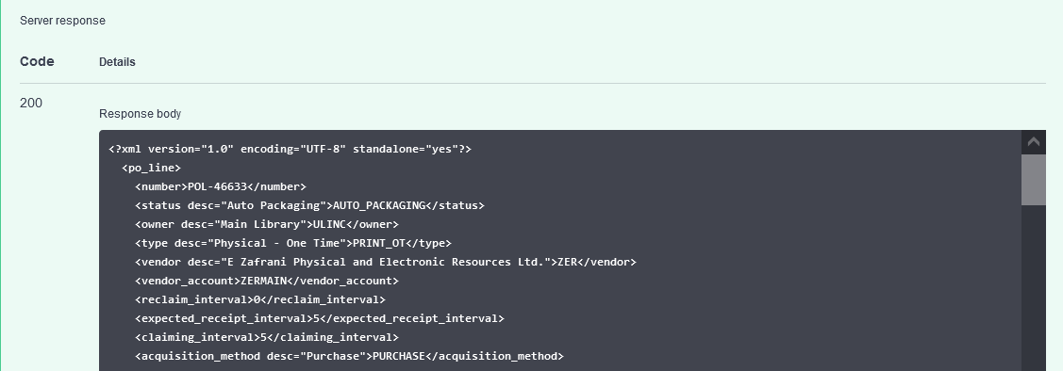
Testing the restriction profile – Creating a POL
A new POL is successfully created

Slide 19
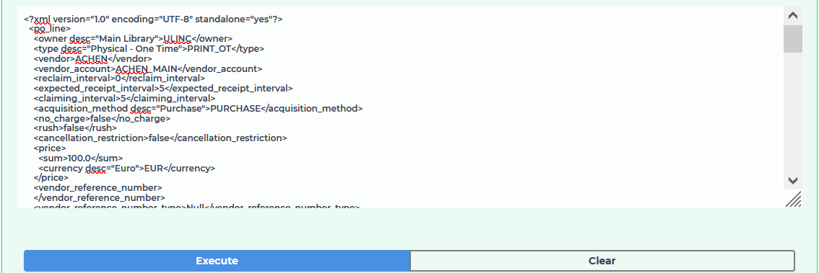
Testing the restriction profile – Creating a POL
Now we will use the same API key to create (POST) an order for a different vendor
Now the vendor code is ACHEN instead of ZER

Slide 20
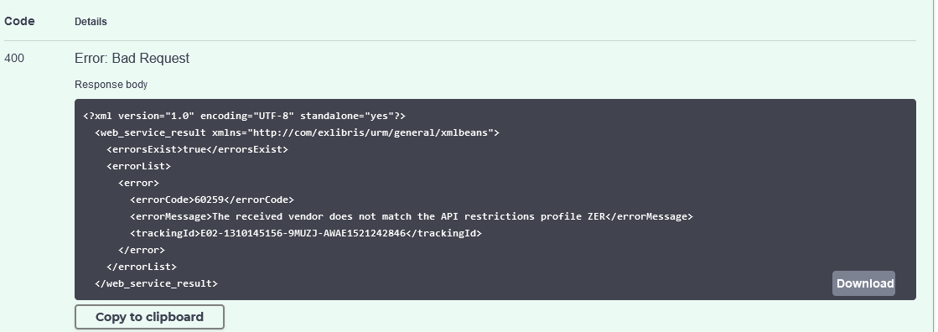
Testing the restriction profile – Creating a POL
The POL is not created.
A message is returned "The received vendor does not match the API restrictions profile ZER".

Slide 21
Testing the restriction profile – Retrieving a POL

Slide 22
Testing the restriction profile – Retrieving a POL
In this example we will see that when using an API connected to the restriction profile which has vendor ZER
  We can retrieve a POL if the code of the vendor of the POL is ZER
  We cannot retrieve a POL if the code of the vendor of the POL is not ZER.
Thus, we are restricted to retrieve a POL according to the vendor
We are using the API Key which is connected to the integration profile with the API Restriction limited to vendor ZER

Slide 23
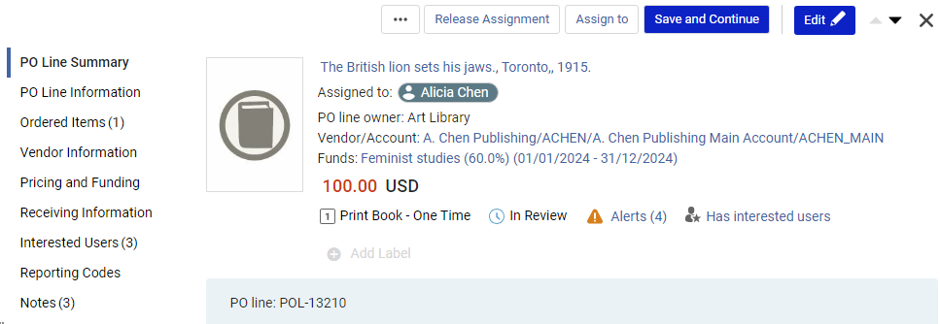
Testing the restriction profile – Retrieving a POL
Now we will try to retrieve POL-13210 which has vendor with code ACHEN.
We will use the API key connected to restriction profile ZER (which is also connected to vendor ZER). We cannot retrieve the POL

Slide 24
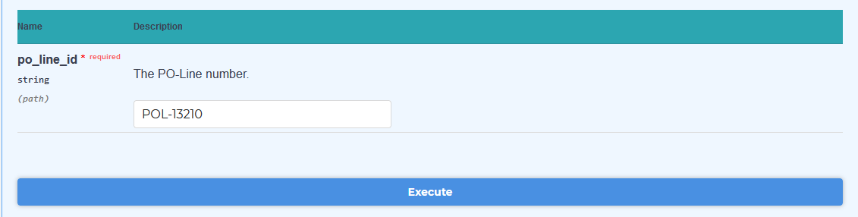
Testing the restriction profile – Retrieving a POL
We do a GET for the POL

Slide 25
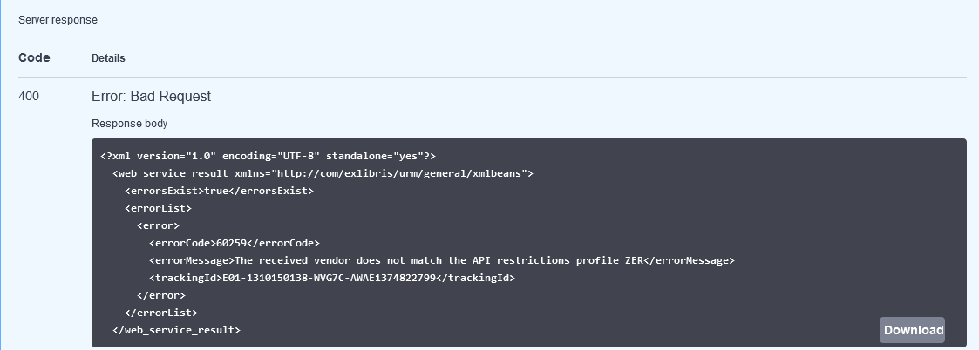
Testing the restriction profile – Retrieving a POL
We get a response “The received vendor does not match the API restrictions profile ZER”

Slide 26
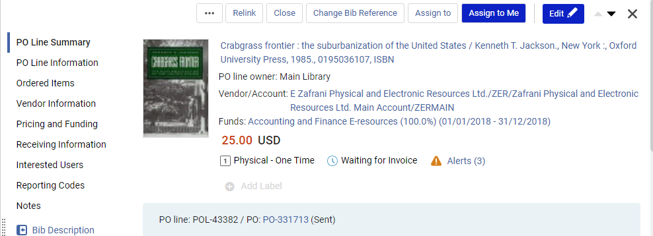
Testing the restriction profile – Retrieving a POL
Now we will try to retrieve POL-43382 which has vendor with code ZER.
We will use the API key connected to restriction profile ZER (which is also connected to vendor ZER). We cannot retrieve the POL

Slide 27
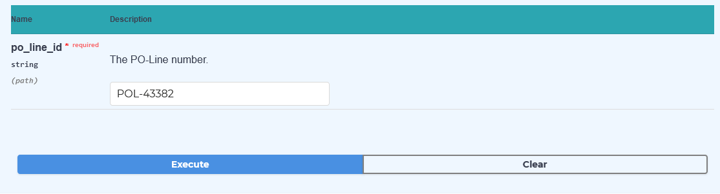
Testing the restriction profile – Retrieving a POL
We do a GET for the POL

Slide 28
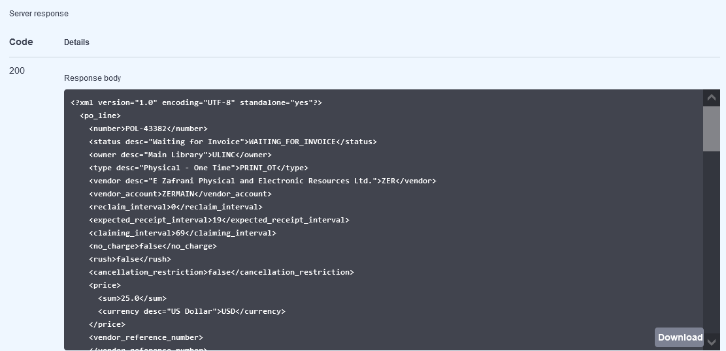
Testing the restriction profile – Retrieving a POL
The POL is successfully retrieved

Slide 29
Testing the restriction profile – Retrieving vendors

Slide 30
Testing the restriction profile – Retrieving vendors
In this example we will see that when using an API connected to the restriction profile which has vendor ZER
  We can retrieve a vendor if the code of the vendor is ZER
  We cannot retrieve a vendor if the code of the vendor is not ZER.
Thus, we are restricted to retrieve a specific vendor
We are using the API Key which is connected to the integration profile with the API Restriction limited to vendor ZER

Slide 31
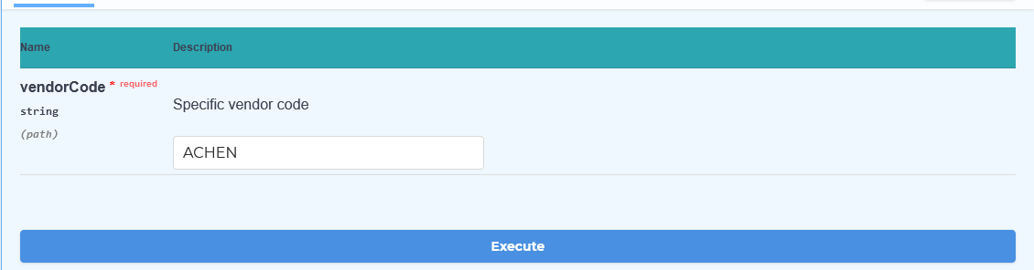
Testing the restriction profile – Retrieving vendors
If we try to retrieve a vendor which is not code ZER then we get the message “The received vendor does not match the API restrictions profile ZER”
Below the user uses the API key connected to restriction profile ZER
The user tries to retrieve (GET) vendor ACHEN.

Slide 32
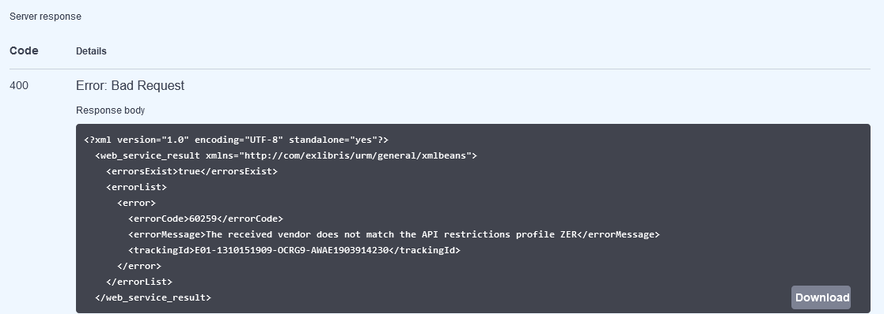
Testing the restriction profile – Retrieving vendors
The user gets message “The received vendor does not match the API restrictions profile ZER”

Slide 33
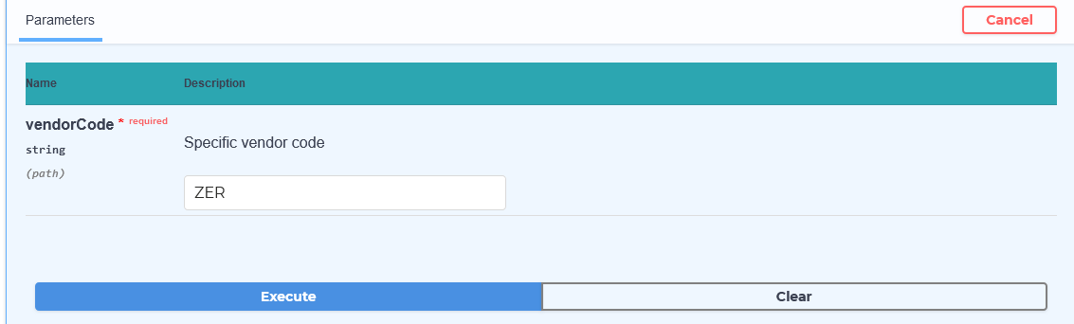
Testing the restriction profile – Retrieving vendors
Now we will try to retrieve the vendor ZER. This is the vendor associated with the restriction profile.
The user uses the API key connected to restriction profile ZER
The user is successful

Slide 34
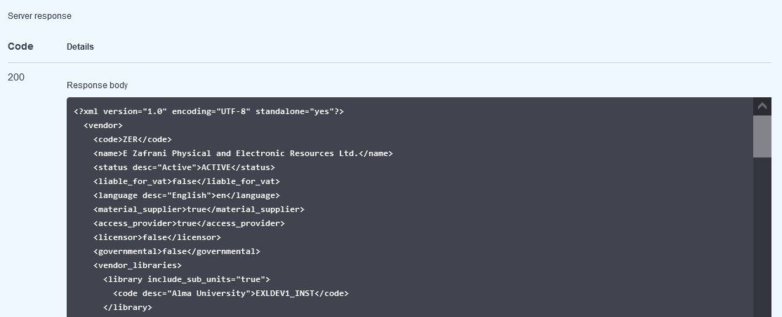
Testing the restriction profile – Retrieving vendors
The vendor is retrieved

Slide 35
Testing the restriction profile – Viewing funds

Slide 36
Testing the restriction profile – Viewing funds
In this example we will see that when using an API connected to the restriction profile which has “Fund(s) view” = brief
  We cannot see the “balance” of any fund
Thus, we are restricted to view “balance” when retrieving a fund.
We are using the API Key which is connected to the integration profile with the API Restriction limited to vendor ZER which also has “Fund(s) view” = brief

Slide 37
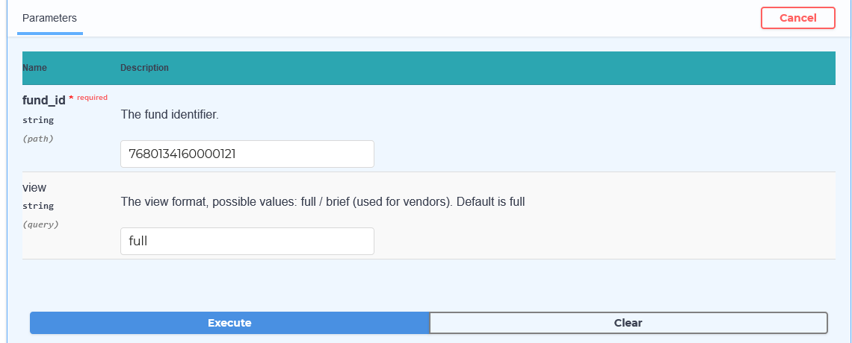
Testing the restriction profile – Viewing funds
We will try to retrieve fund ID 7680134160000121 (which is fund code LIS)

Slide 38
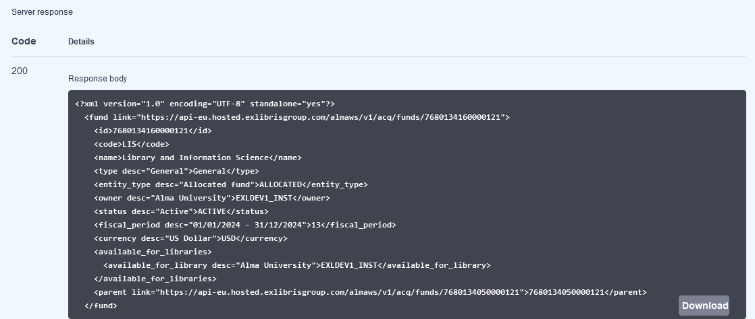
Testing the restriction profile – Viewing funds
We do not see the balance
There is no balance information between <currency> and <available_for_libraries>

Slide 39
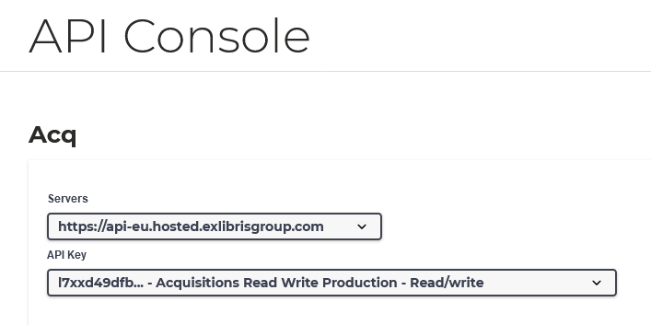
Testing the restriction profile – Viewing funds
Now we will do the same GET (retrieval) with an API key which is not connected to restriction profile ZER
We are using the API Key which is not connected to the integration profile with the API Restriction limited to vendor ZER

Slide 40
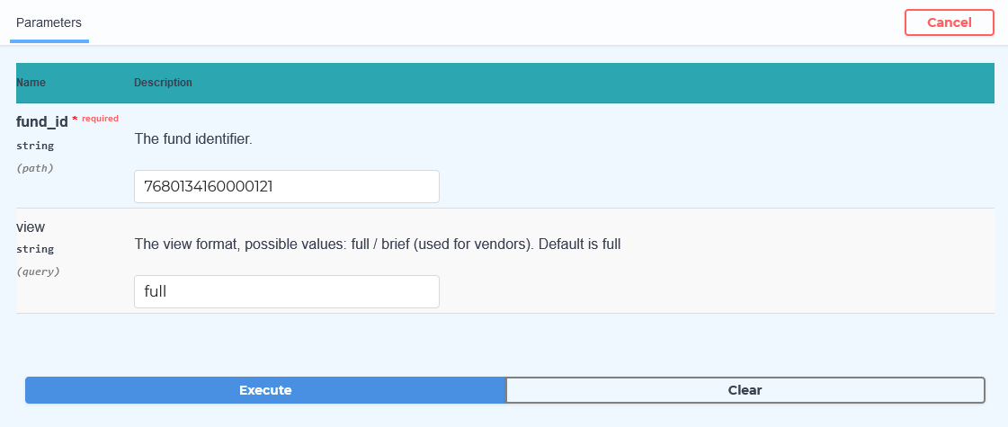
Testing the restriction profile – Viewing funds
We the same GET (retrieval) with an API key which is not connected to restriction profile ZER

Slide 41
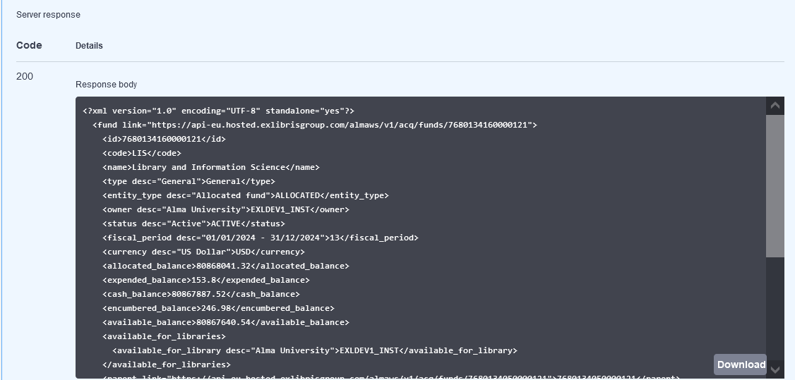
Testing the restriction profile – Viewing funds
Now we do see the balance
There is balance information between <currency> and <available_for_libraries>

